Slide 1



WELCOME TO

Slide 2

Objective of the Training
Become a Full Stack developer by gaining all the skills required to work with front-end and back-end technologies.

Slide 3

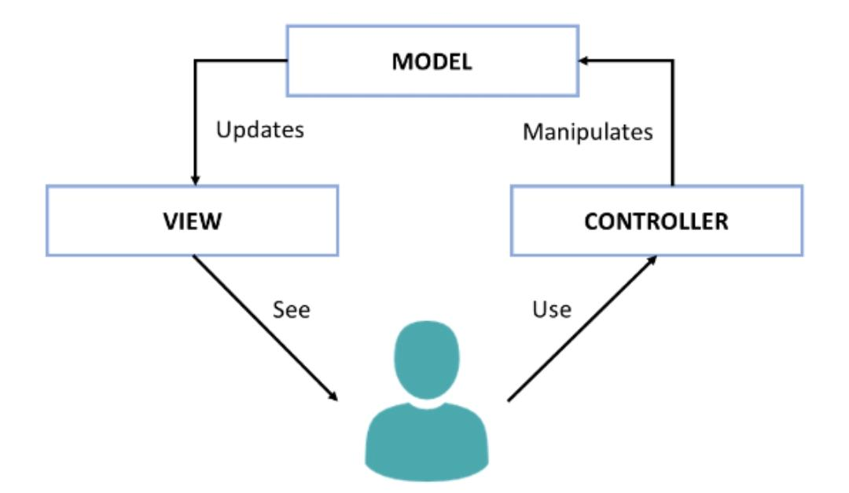
MVC

Slide 4
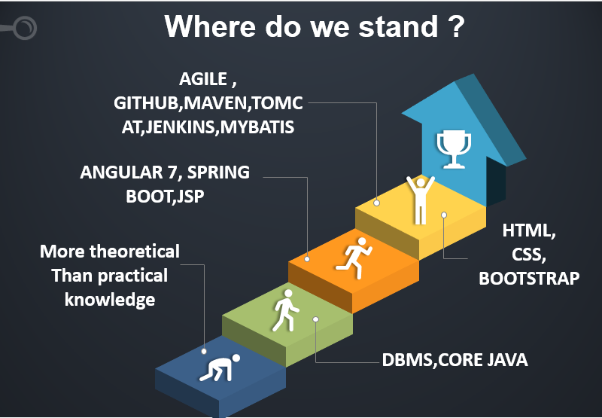


Slide 5

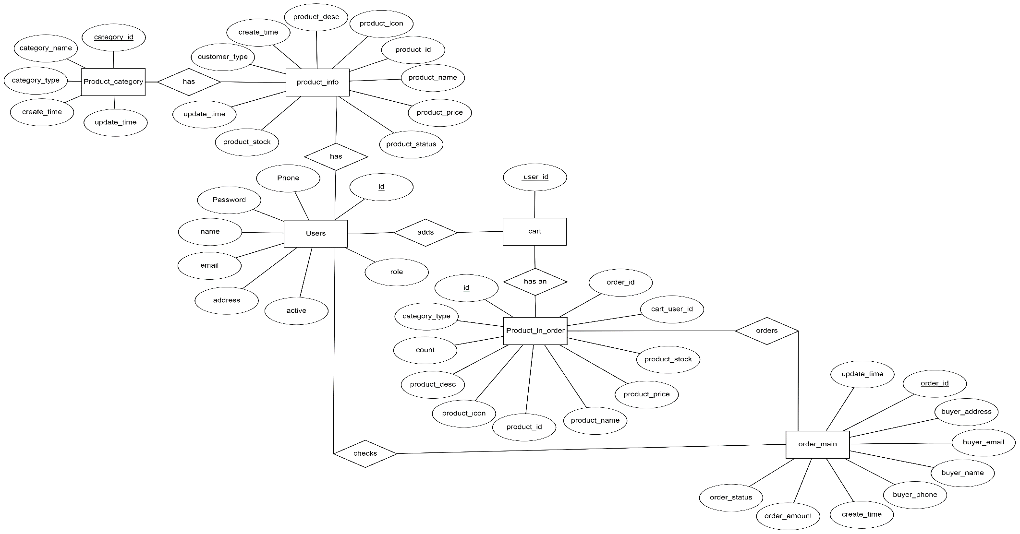
ER Diagram

Slide 6
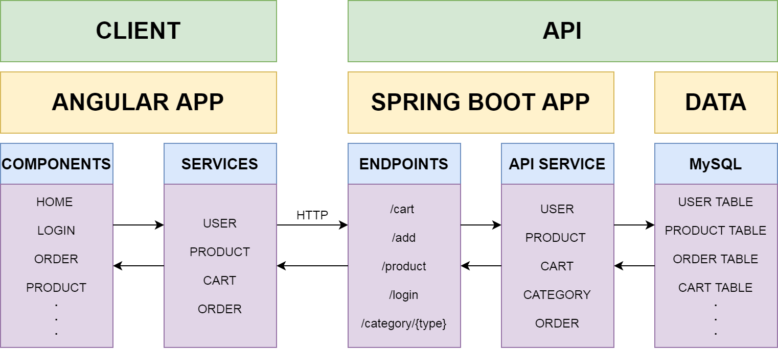
Full Stack Architecture

Slide 7
Project E-Commerce Web Application
E-Commerce Web Application allows us to perform all shopping related CRUDe operations.

Slide 8
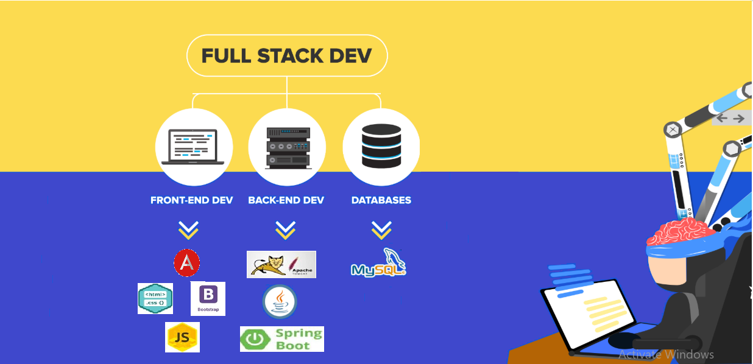

Slide 9
Problem Definition
To develop an interactive Ecommerce Application where one can perform Online Shopping

Slide 10

SNAPSHOTS

Slide 11
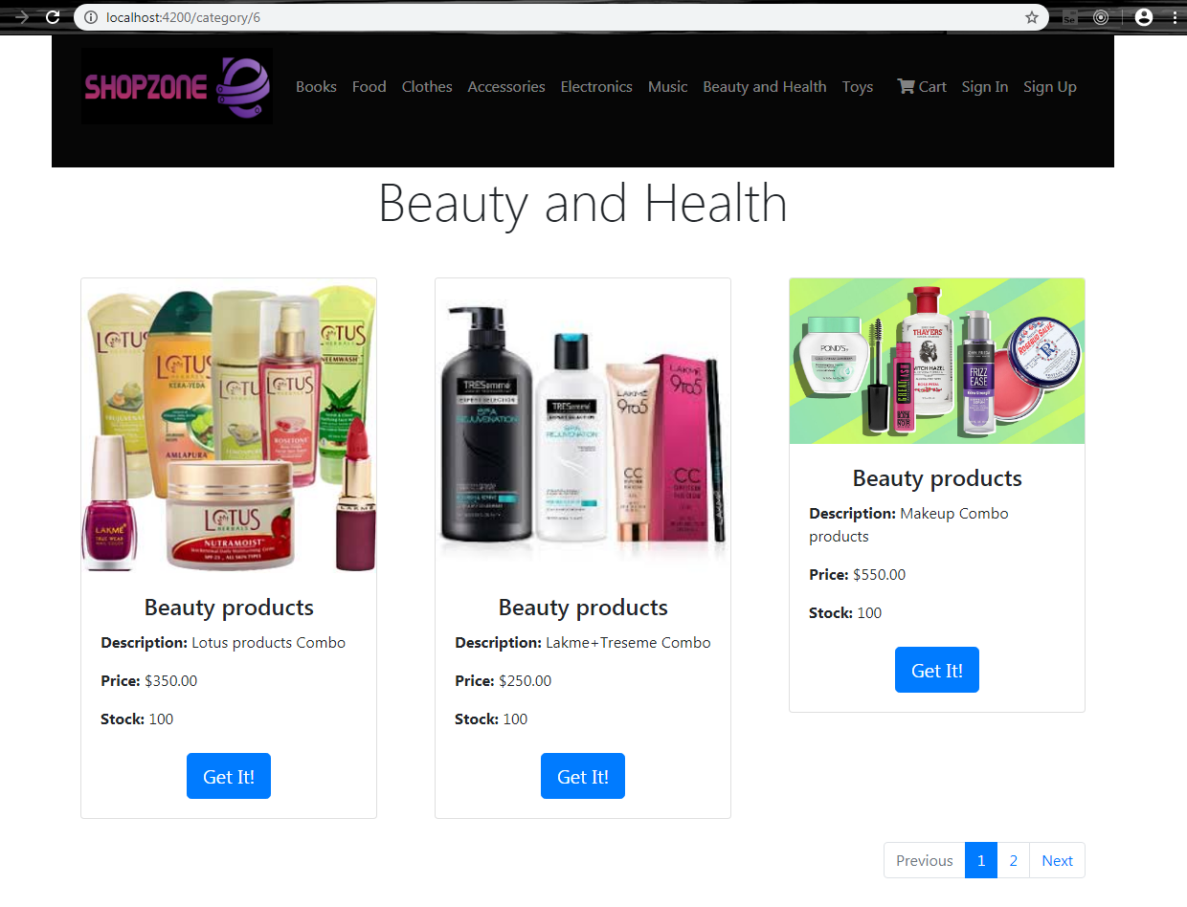
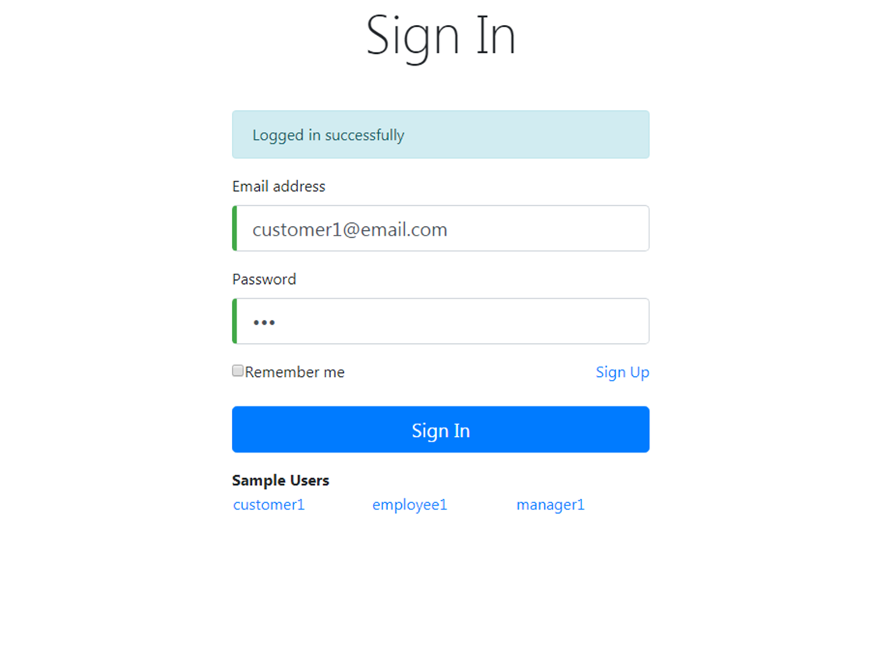

Slide 12
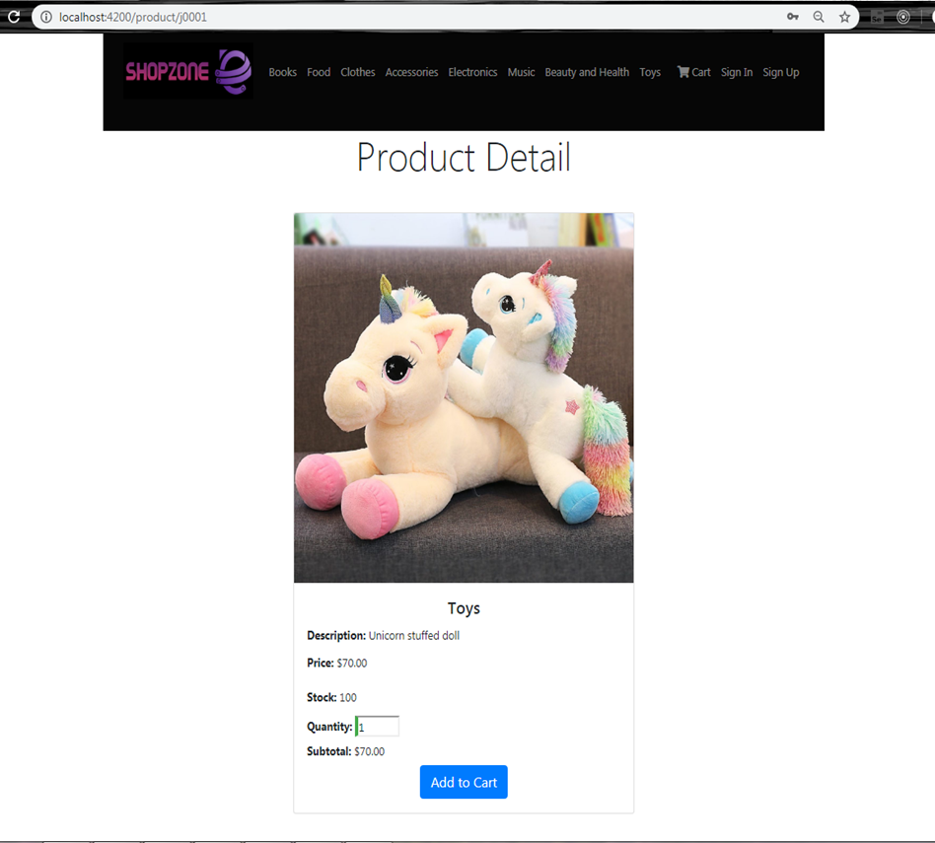
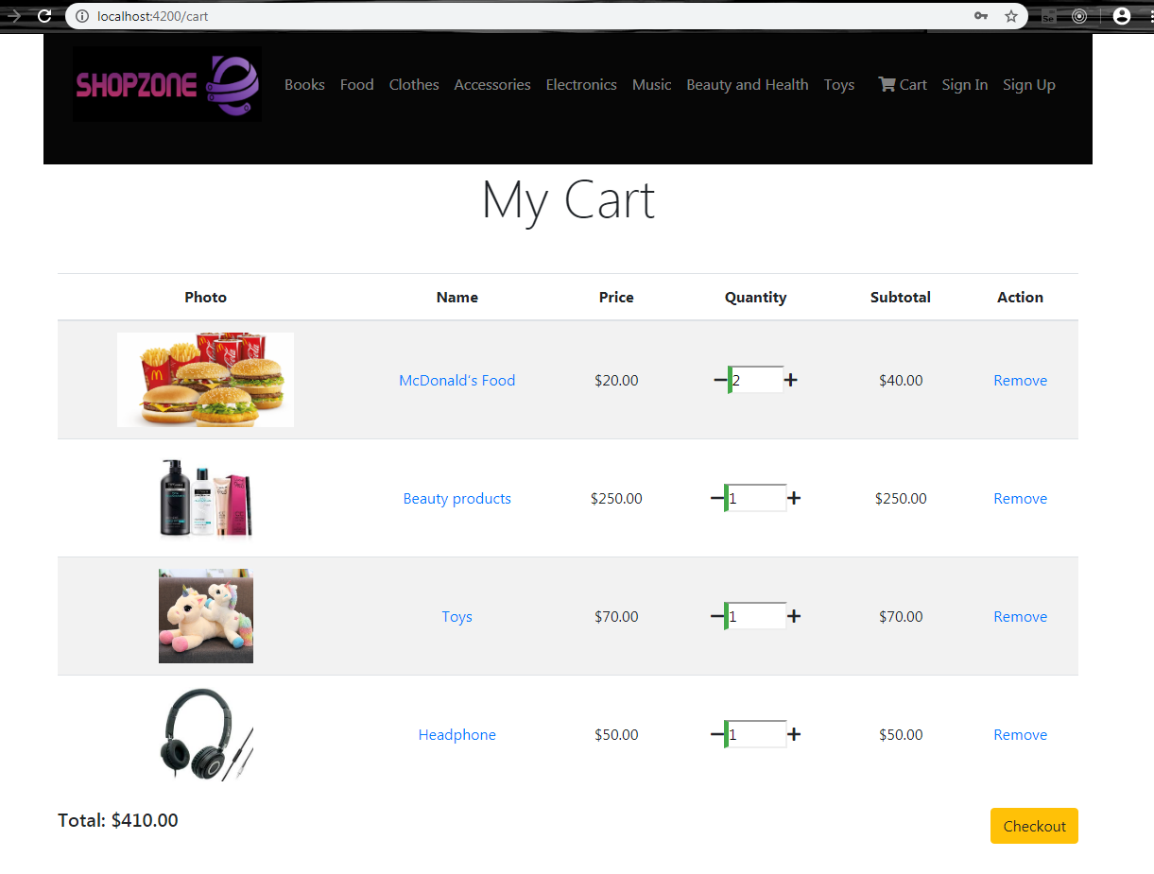

Slide 13
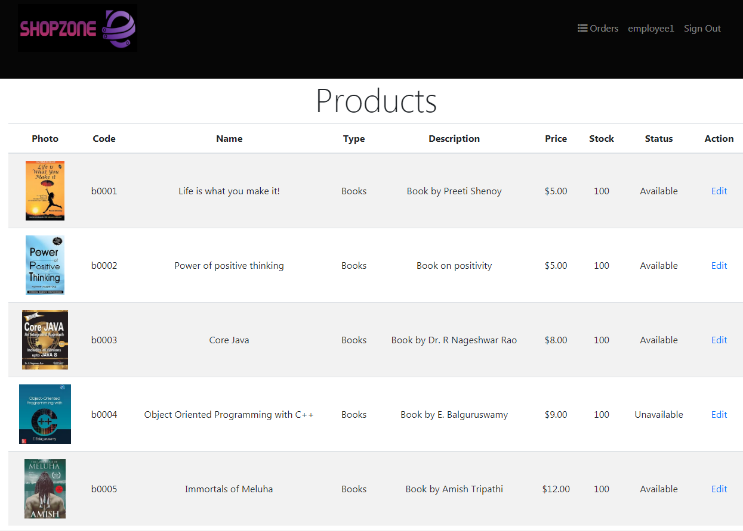

Slide 14
Conclusion
Today’s businesses must always strive to create the next best thing that consumers will want because consumers continue to desire their products, services etc. to continuously be better, faster, and cheaper. In this world of new technology, businesses need to accommodate to the new types of consumer needs and trends because it will prove to be vital to their business’ success and survival. E-commerce is continuously progressing and is becoming more and more important to businesses as technology continues to advance and is something that should be taken advantage of and implemented.

Slide 15

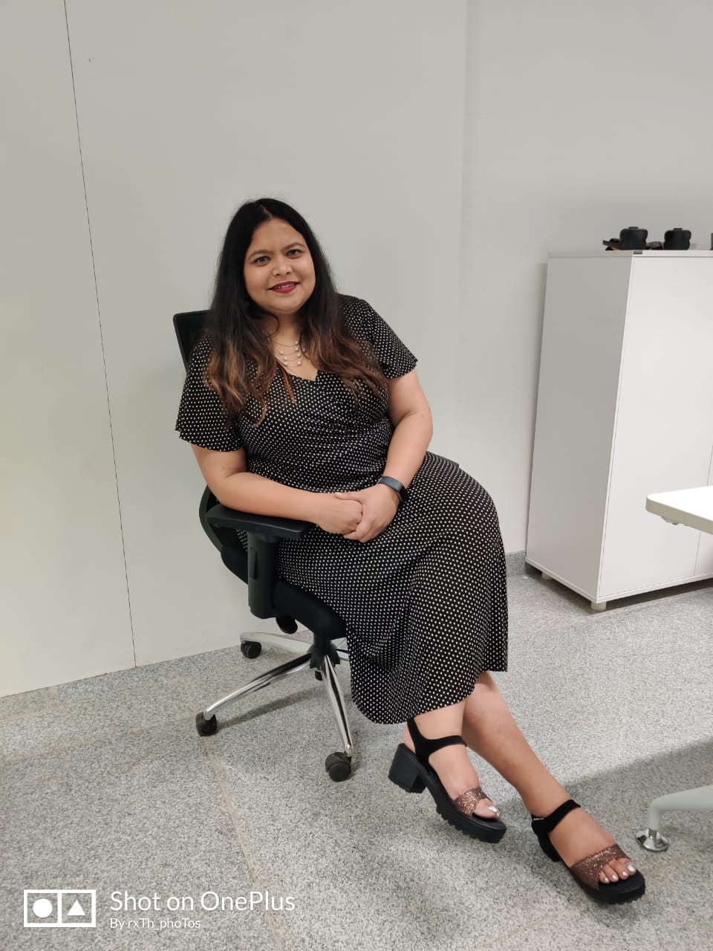



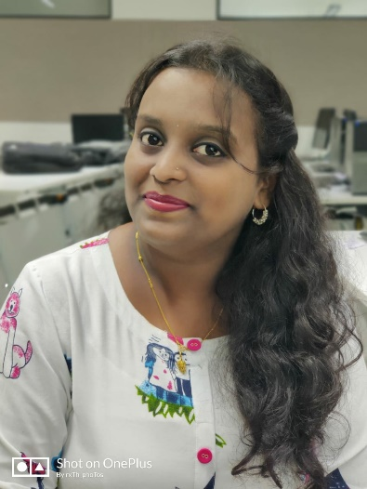
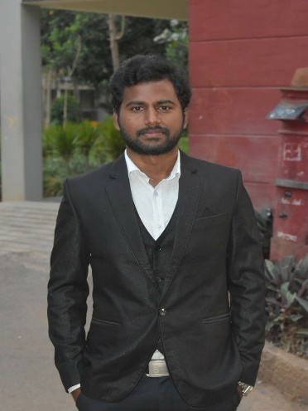
TRAINER
TEAM-IGNITE
Upasana
Bhyravi
Divya
Sangeeta
Ramya
Santhosh

Slide 16

THANK YOU

Slide 17
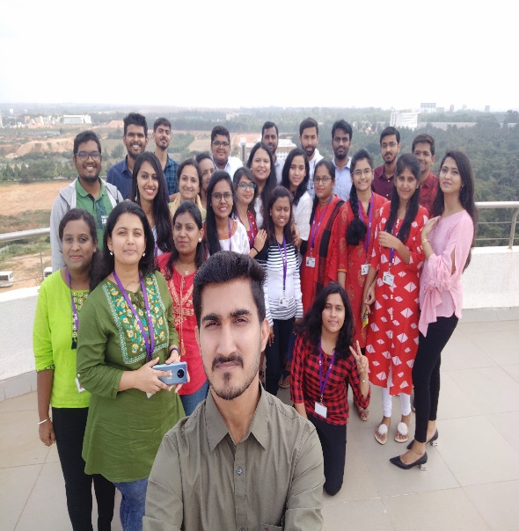

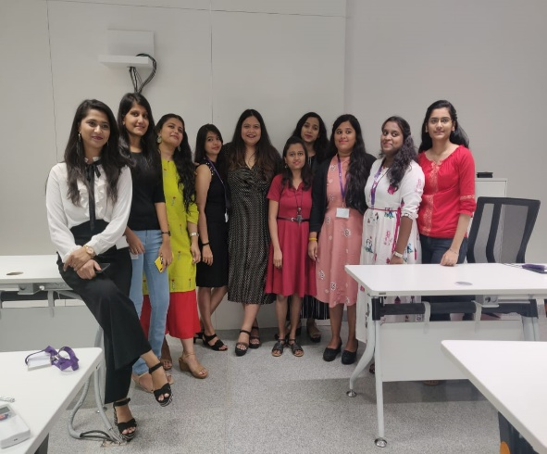
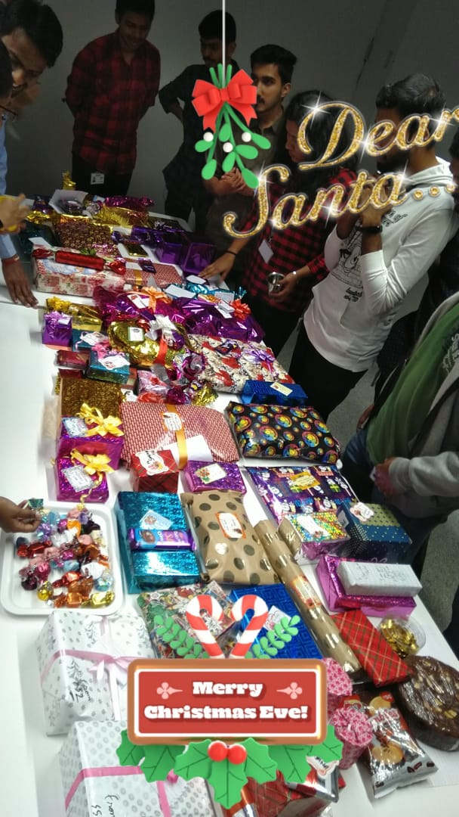

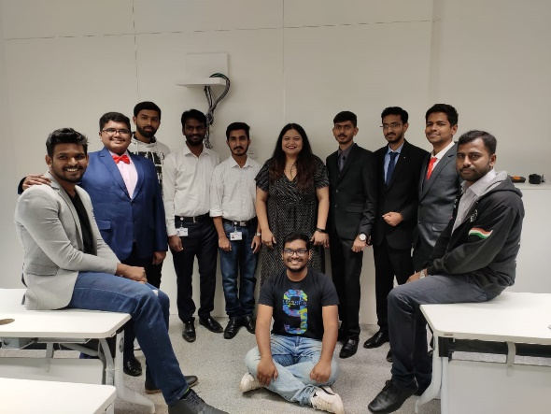
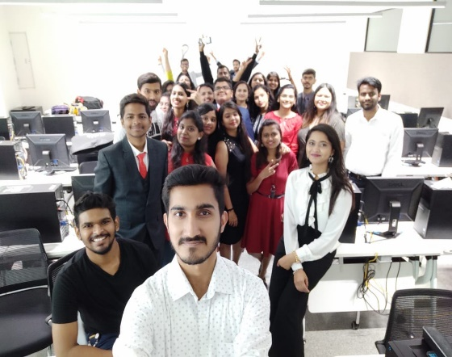
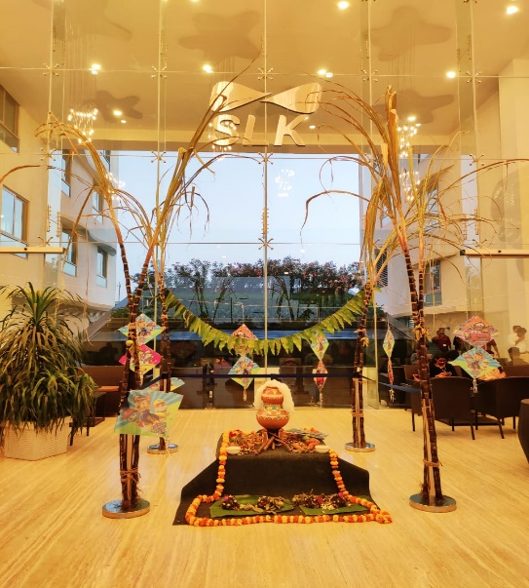
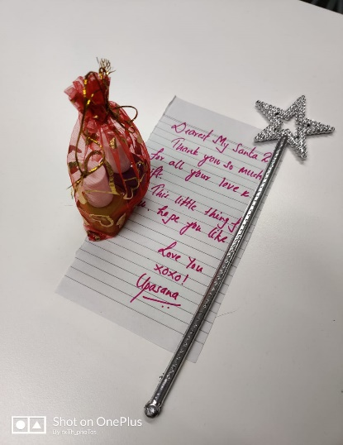
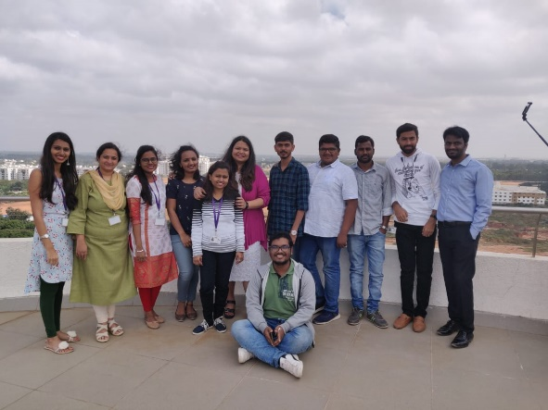
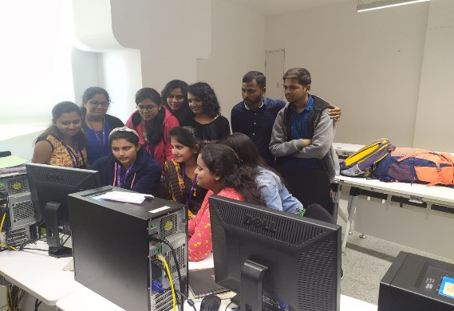
FUN AT WORK

